Slide 1
One Day Administrative Staff Training Programme on Hands on Training on
COMPUTER DATA ENTRY held on
4TH April 2016
Organised by Internal Quality Assurance Cell (IQAC)
SDM Govt. Music College, Agartala

Slide 2
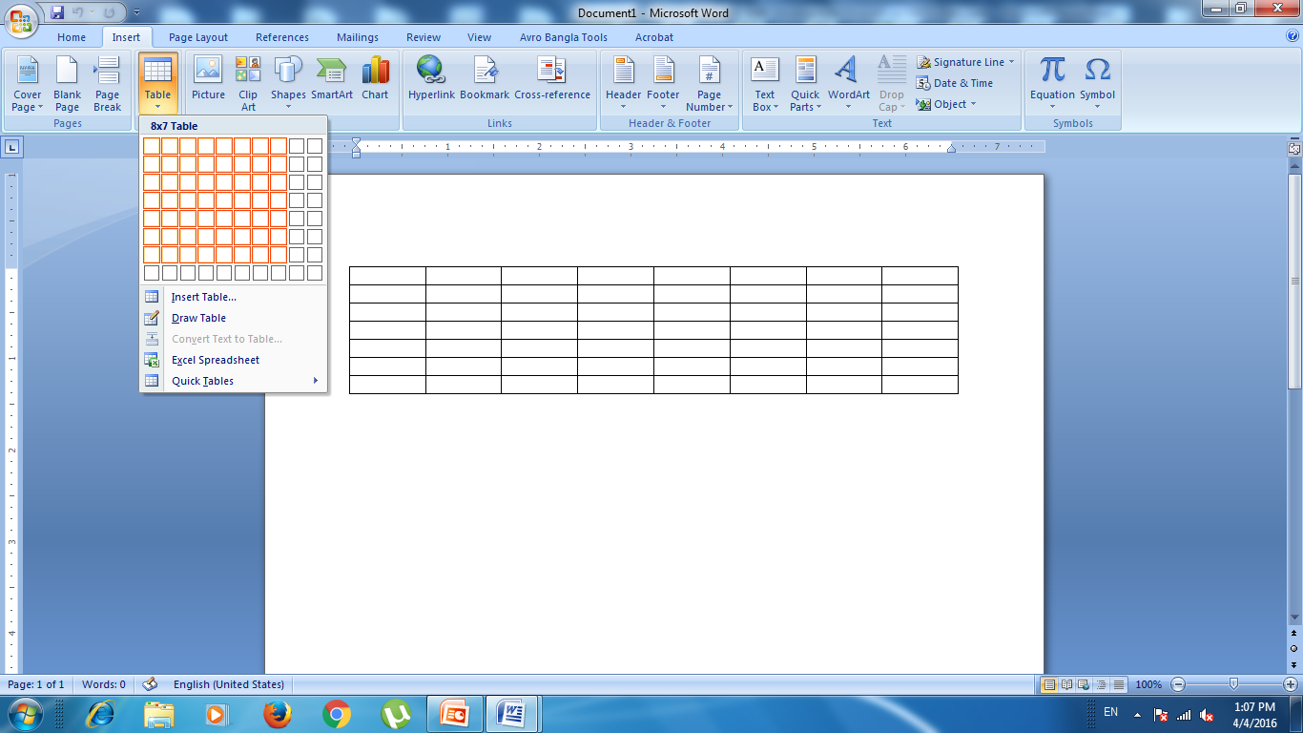
Table Insert

Slide 3
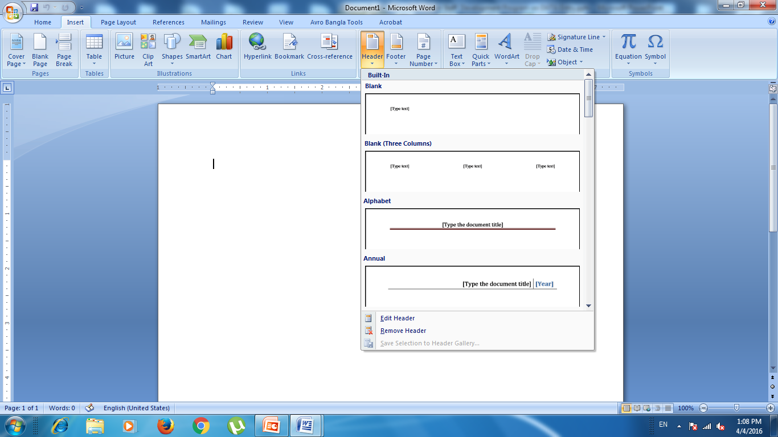
Header & Footer

Slide 4
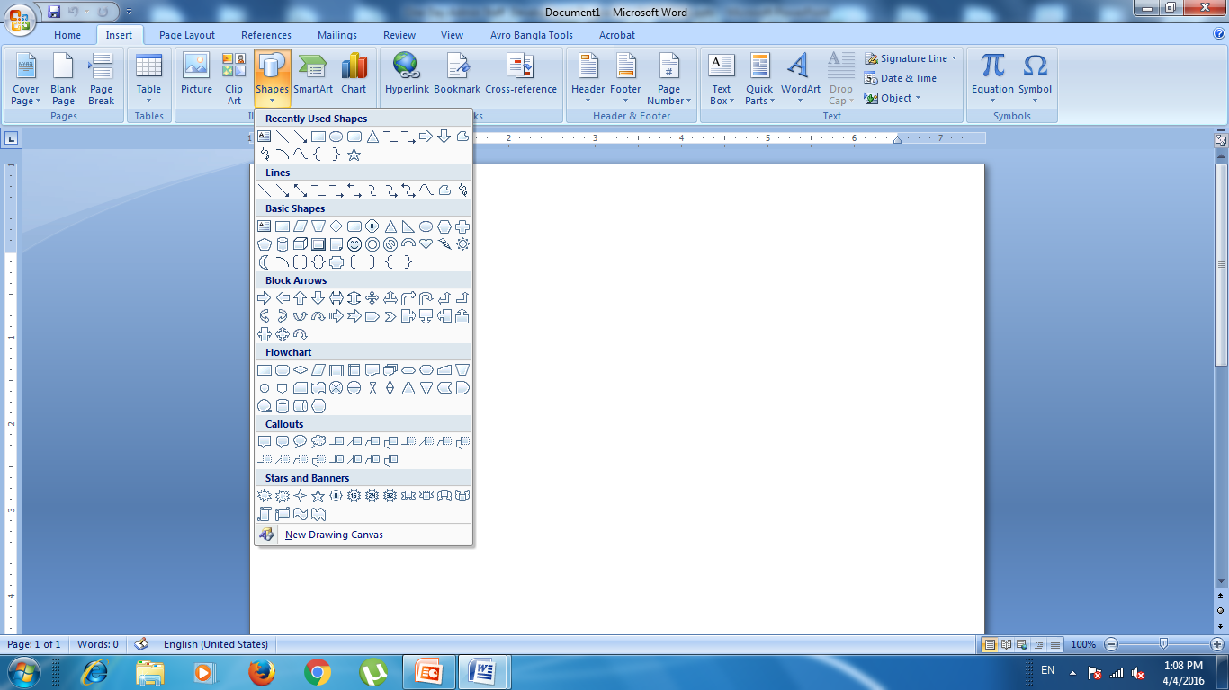
Shapes

Slide 5

Page layout

Slide 6

Colours

Slide 7

Fonts

Slide 8
End of Data Entry
Thank you

